Slide 1
Nonideal Effects in SC circuits
Gabor C Temes
School of EECS
Oregon State University
Rev. 9/4/2011

Slide 2
Components and Nonidealities
Switches:
Nonzero “on”-resistance
Clock feedthrough / charge injection
Junction leakage, capacitance
Noise
Capacitors:
Capacitance errors
Voltage and temperature dependence
Random and systematic variations
Leakage
Op-amps:
DC offset voltage
Finite dc gain
Finite bandwidth
Nonzero output impedance
Noise

Slide 3
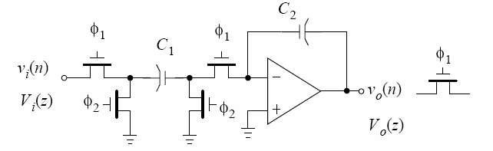
Switched-Capacitor Integrator

Slide 4
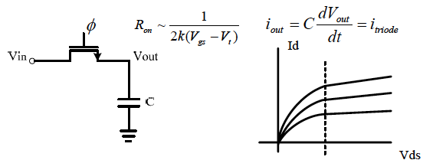
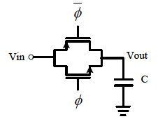
Nonzero Switch “On”-Resistance
C is charged exponentially. Time constant must be sufficiently low.
Body effect must be included!
To lower on-resistance and clock feedthrough: CMOS gate; Wp,Lp =Wn,Ln. For settling to within 0.1%, T_{settling} > 7R_{on}C (worst-case R_{on}).

Slide 5
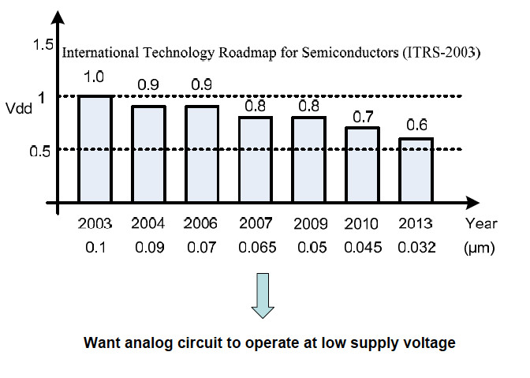
Digital CMOS Scaling Roadmap

Slide 6
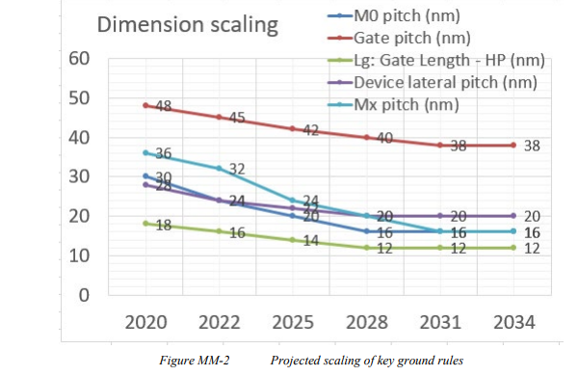
Predicted Dimensions

Slide 7
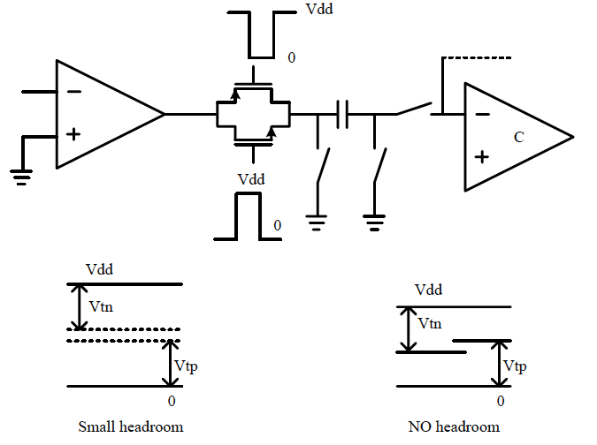
Floating Switch Problem in Low-Voltage
FORBIDDEN REGIONS FOR SIGNAL

Slide 8
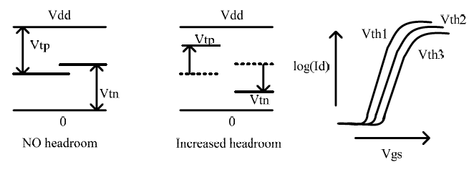
Using Low-Threshold Transistors
Precise control over process and temperature difficult
Switch leakage worsens as threshold voltage is lowered (i.e. hard to turn off)

Slide 9
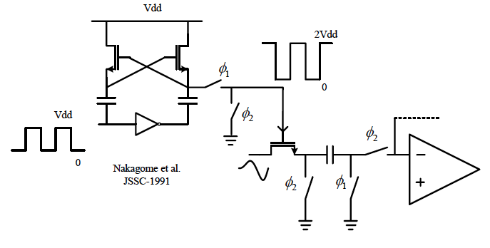
Using Clock Voltage Booster
Boosted clock voltage (e.g. 0 → 2Vdd) is used to sufficiently overdrive the NMOS floating switch – useful in systems with low external power supply voltage and fabricated in high-voltage CMOS process
Battery,harvested energy may be used!
→ Voltage limitation is violated in low-voltage CMOS
0, Vdd-Vt, 2Vdd-2Vt, … 2Vdd

Slide 10
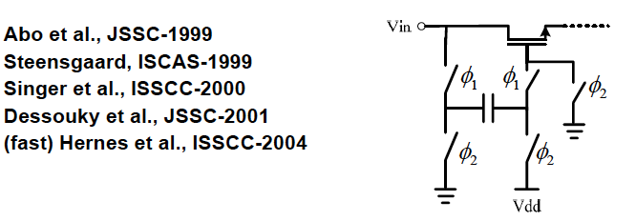
Using Boostrapped Clock
Principle: pre-sample Vdd before placing it across Vgs (various low-voltage issues complicate implementation)
Input sampling such as this can be used for low-voltage CMOS or for high-linearity sampling
No fundamental or topological limitation on higher input signal frequency vs. sampling frequency
BUT BREAKDOWN, ADDED SWITCH TURN-ON PROBLEM.

Slide 11
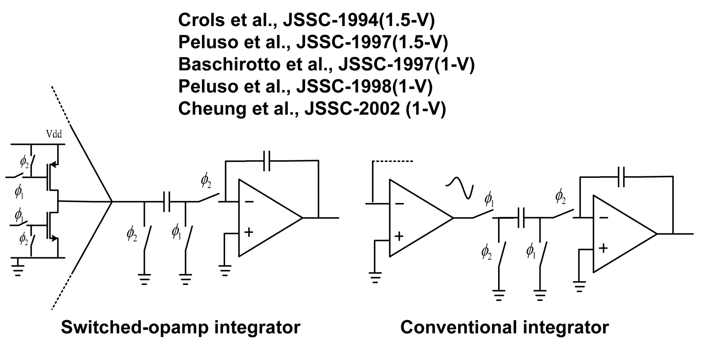
Switched-Opamp Technique
Floating switch is eliminated
Opamp output tri-stated and pulled to ground during reset ϕ₂
→ Slow transient response as opamp is turned back on during ϕ₁

Slide 12
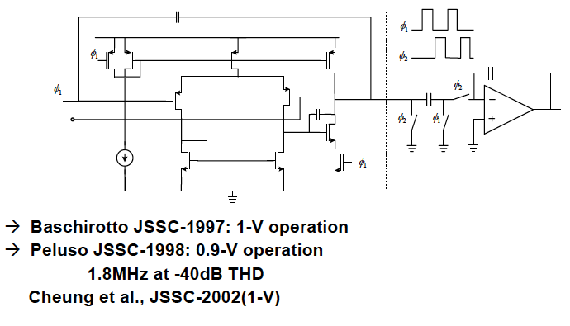
Switched-Opamp Example
Crols et al., JSSC-1994
Peluso et al., JSSC-1997
The entire opamp is turned off during ϕ_{2 .}
Demonstrated 1.5-V operation (ΔΣ)with Vtn=|Vtp|=0.9V.
115kHz at -60dB THD & 500kHz at -72dB THD.

Slide 13
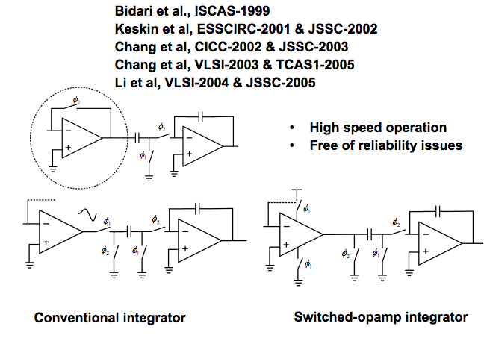
Opamp-Reset = Unity-Gain Configuration

Slide 14
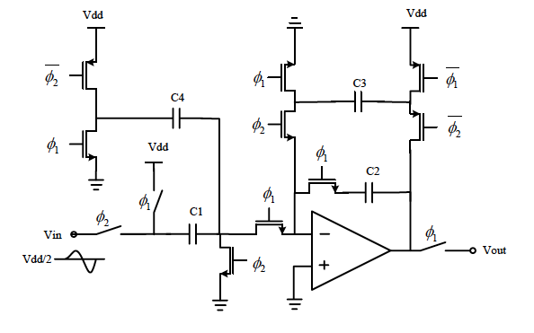
Floating Reference Avoids Fwd Bias
C3 is precharged during ϕ₁
C3 (floating reference) in feedback during ϕ₂
DC offset circuit (C4=C1/2) compensates for Vdd reset of C1
→ effective virtual ground = Vdd/2
Simpler: 2 switches in series with C2, grounded
turned off first.

Slide 15
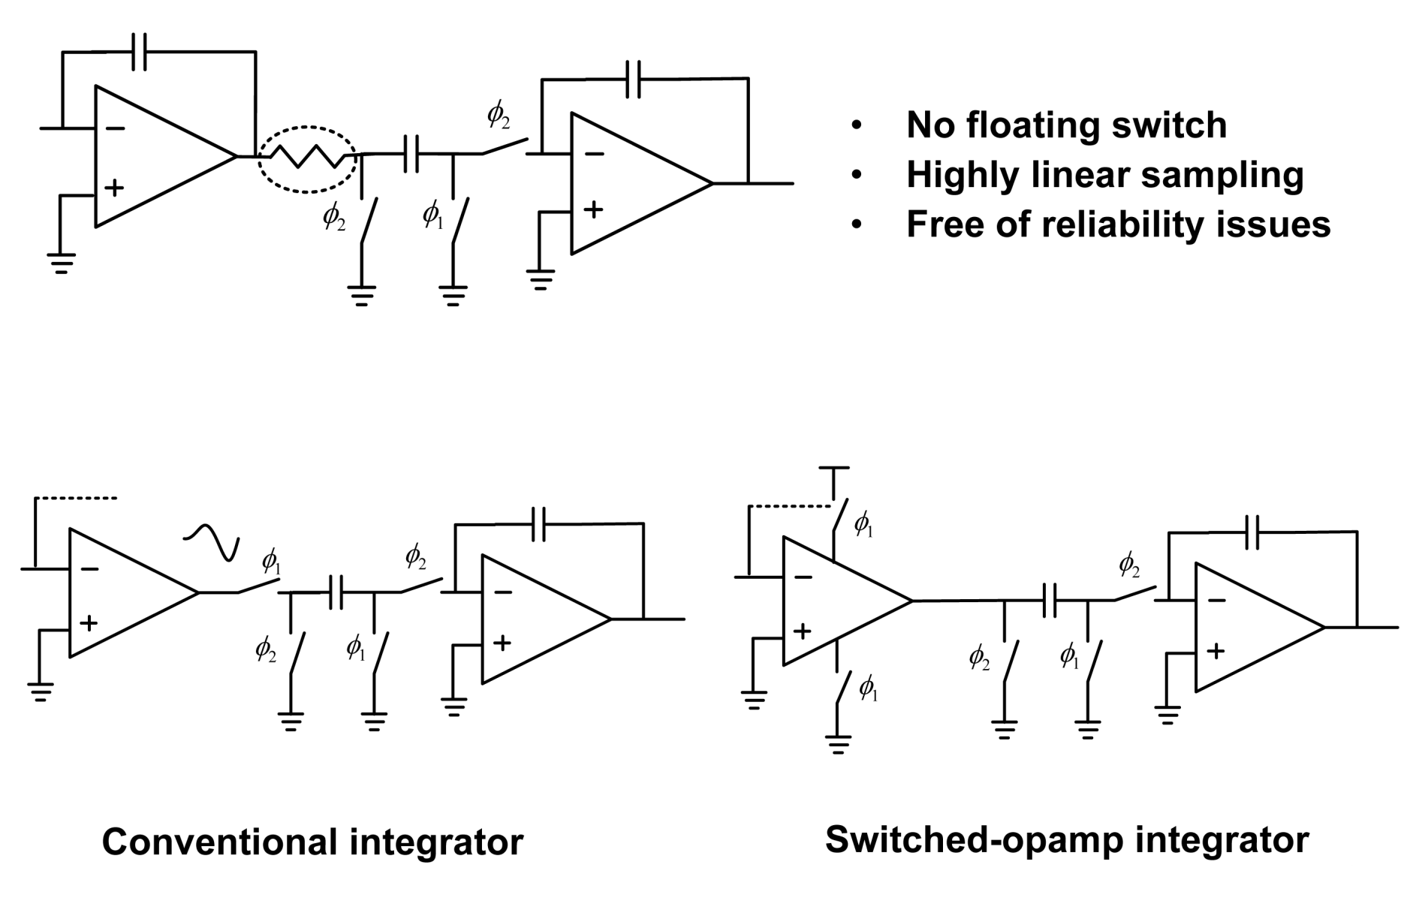
Switched-RC = Resistor Isolation
R must be chosen properly.

Slide 16
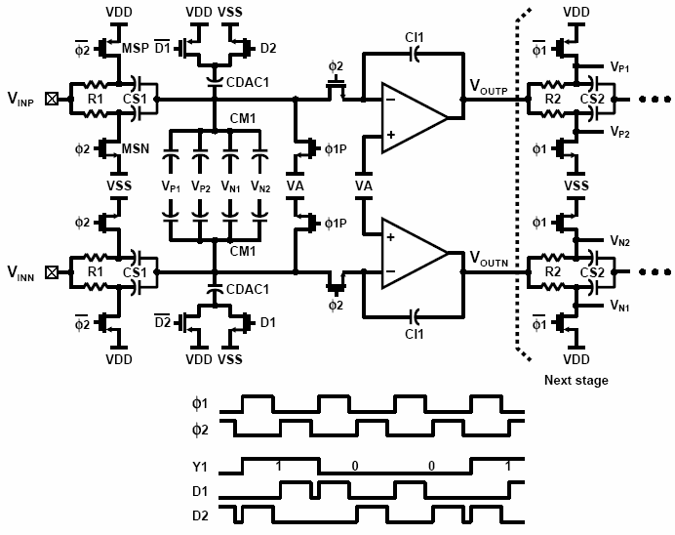
Switched-RC = Resistor Isolation
Ahn et al., ISSCC-2005 Paper 9.1

Slide 17
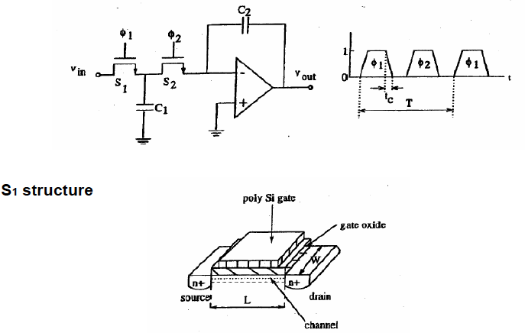
Charge Injection (1)
Simple SC integrator

Slide 18



Charge Injection (1) (Cont’d)
The lateral field is v/L , the drift velocity is μv/L. Therefore, the current is
The on-resistance is
and hence
holds.

Slide 19



Charge Injection (2)
From device physics,
Unless S1 is in a well, connected to its source, Vtn depends on Vin, so qch is a mildly nonlinear function of Vin.
When S1 cuts off, part of qch(qs) enters C1 and introduces noise, nonlinearily, gain and offset error.
To reduce qs, choose L small, but and Ron large. However, for 0.1% settling
Hence
and
Pedestal voltage
where

Slide 20


Clock Feedthrough
Capacitive coupling of clock signal via overlap Cov between gate and source. The resulting charge error is
It adds to qs . Usually,
Linear error .
Same for S₁ and S_{2.}

Slide 21
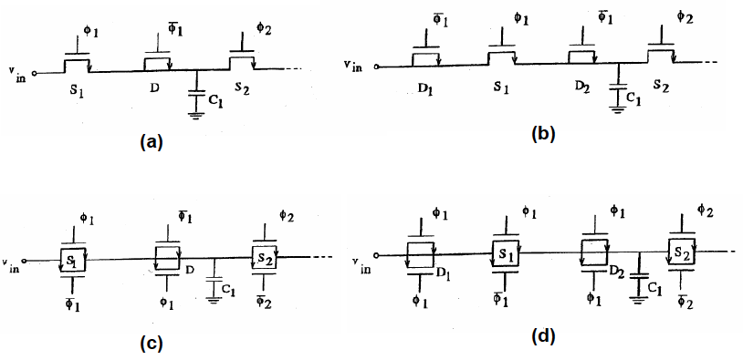
Methods for Reducing Charge Injection
Transmission gates: cancellation if areas are matched. Poor for floating switches, somewhat better for fixed-voltage operation.
Dummy devices: better for d~0.5.

Slide 22
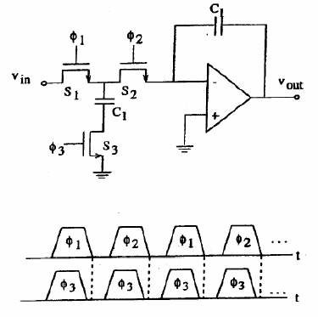
Advanced-Cutoff Switches
Signal-dependent charge injection leads to nonlinear distortions; signal-independent one to fixed offset. Advanced-cutoff switches can reduce signal dependence.

Slide 23
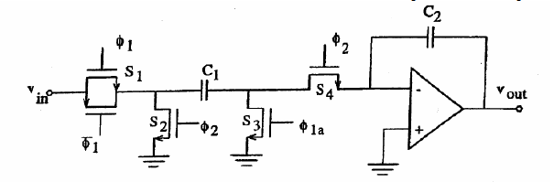
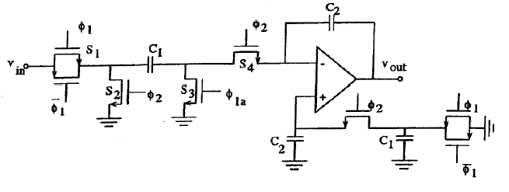
Advanced-Cutoff Switches (Cont’d)
Remaining charge injection is mostly common-mode in a differential stage.
Suppressed by CMRR. In a single-ended circuit, it can be approximated by dummy branch:

Slide 24
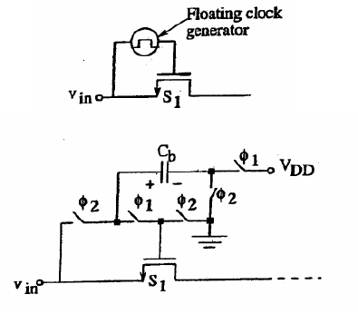
Floating Clock Generator
To reduce signal dependence, reference the clock signal to vin:
This makes Ron also signal independent, so the settling is more linear. Clock feedthrough remains signal dependent, but it is a linear effect anyway. Better phasing : precharge Cb to VDD during phase 2, connect to vin during phase 2.

Slide 25
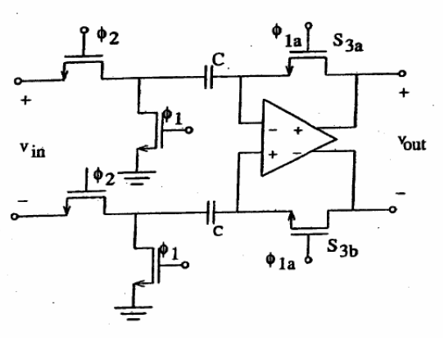
Charge Injection in a Comparator
Remains valid if input phases are interchanged.

Slide 26
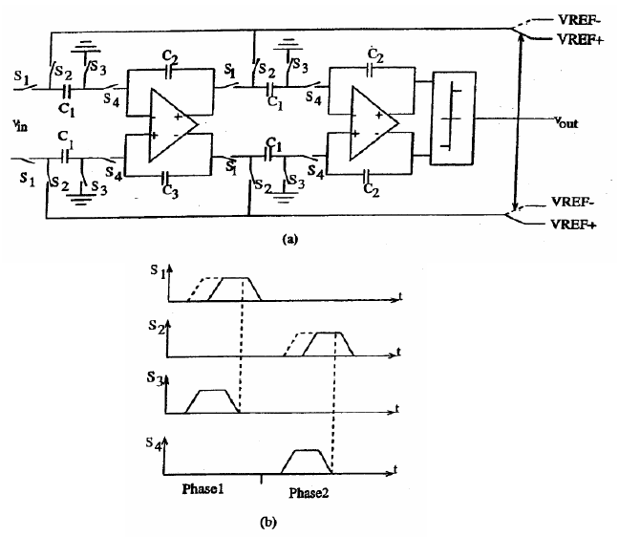
Delta-Sigma ADC

Slide 27
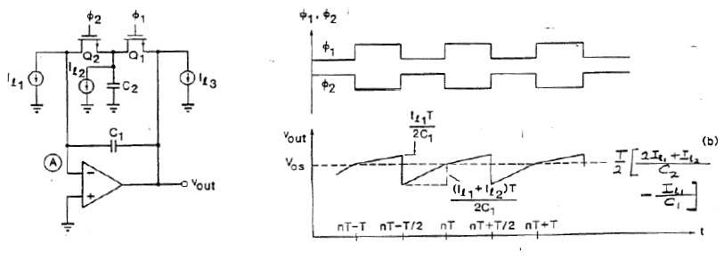
Junction Leakage
I ~10 pA/mil² , 0.4pA/5μ x 5μ but doubles for each 10°C.
fmin ~ 100Hz at 20°C, but 25KHz at 100° C.
Fully differential circuit and Martin compensation converts it to common-mode effect.

Slide 28
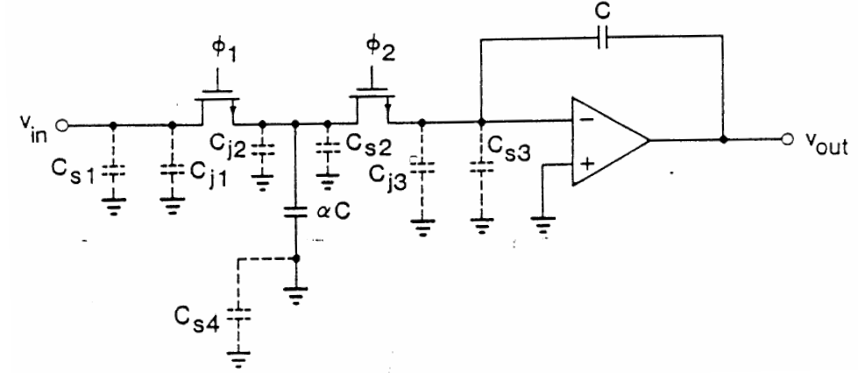
Capacitances Inaccuracies
Depends only on C ratios. Strays are often p-n junctions, leading to harmonic distortion also. For stray-sensitive integrator, all strays should be < 0.1% of αC.
ΔC can be systematic or random. Random effects (granularity, edge effects, etc.) cannot be compensated, but systematic ones can, by unit-capacitor/common-centroid construction of αC and C.

Slide 29
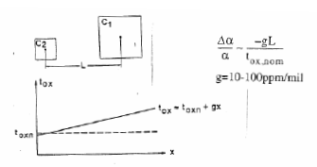
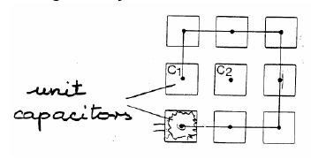
Capacitances Inaccuracies (Cont’d)
Oxide gradient
Common-centroid geometry
Compensated C1/C2 against linear variations of Cox, and edge related systematic errors (undercut, fringing)

Slide 30

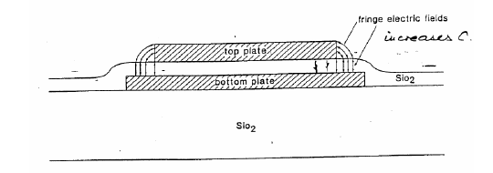
Capacitances Inaccuracies (Cont’d)
Voltage and temperature coefficients
Smaller for ratios, especially for common-centroid layout:
Fringing, undercut: systematic edge effects. Reduced by commoncentroid geometry, since perimeter/area ratio is the same for C1 and C2, .

Slide 31
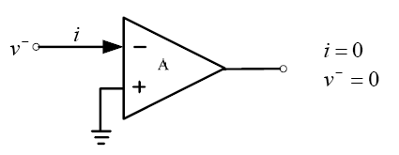
OPAMP Input Offset
In most analog IC, the active element is the opamp. It is used to create a virtual ground (or virtual short circuit) at its input terminals:
This makes lossless charge transfer possible. In fact, in a CMOS IC, i≈0 but v≠0 due to offset, 1/f and thermal noise and finite opamp gain A. Typically, |v|=5-10mV. This affects both the dc levels and the signal processing properties. The effect of v is even more significant in a low-voltage technology where the signal swing is reduced, and A may be low since cascoding may not be available.

Slide 32
Techniques for Reducing the Effect of
Imperfect Virtual Grounds
Autozeroing or Correlated Double Sampling Schemes:
Scheme A: Stores and subtracts v at the input or output of the opamp;
Scheme B: Refers all charge redistributions to a (constant) v instead of ground;
Scheme C: Predicts and subtracts v, or references charge manipulations to a predicted.
Compensation using extra input: An added feedback loop generates an extra input to force the output to a reset value for zero input signal.
Chopper stabilization: The signal is modulated to a “safe” (low-noise) frequency range, and demodulated after processing.
Mixed-mode schemes: Establish a known analog input, use digital output for correction.

Slide 33
Circuits Using Autozeroing
Comparators
Amplifiers
S/H, T/H, delay stages
Data converters
Integrators
Filters
Equalizers

Slide 34
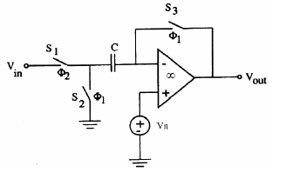


Simple Autozeroed Comparator
Nonidealities represented by added noise voltage:
Input-referred noise at the end of interval:
Transfer function without folding:
Vos, V1/f and (for oversampled signals) µVout may be reduced by HN. Here, µVout is not considered, since it is not important for a comparator.

Slide 35
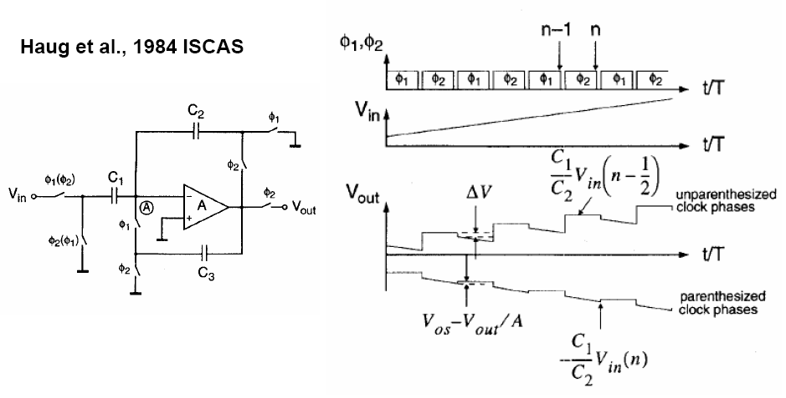
An Offset- and Finite-Gain-Compensated SC
Amplifier

Slide 36

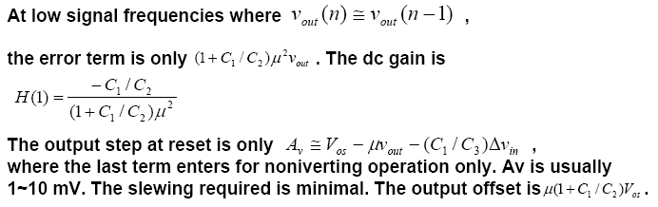
Analysis of Compensated Gain Amplifier
Input-output relation for inverting operation:
The S/H capacitor switches from 0 to
+1
Error in H(1): denom. should have + 1. Clock feedthrough generates some residual offset. Can be used as a compensated delay stage.

Slide 37
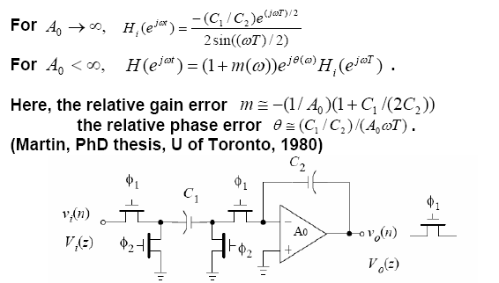
Finite Opamp DC Gain Effect
Equations valid only for high frequencies.
At unity-gain freq.
Usually, the magnitude error is smaller the (C1/C2) error and is negligible. The phase error shifts poles/zeros horizontally, like dissipation: important!

Slide 38
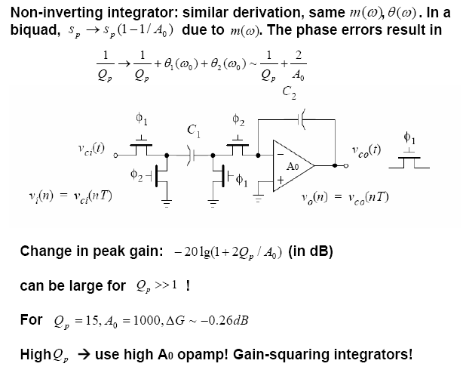
Finite Opamp DC Gain Effect (Cont’d)

Slide 39





Model for Finite - Gain Effect
is the charge flow in one clock period

Slide 40
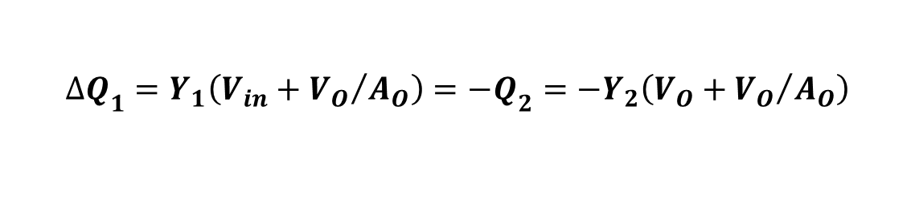
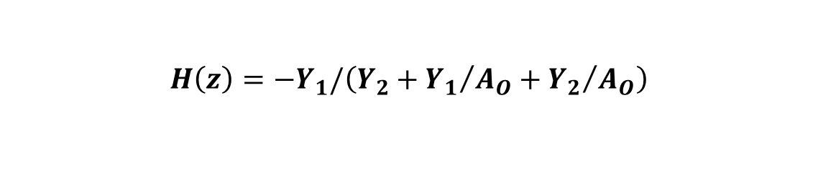

Model for Finite - Gain Effect (Cont’d)
For finite A_{O},
so the model is

Slide 41
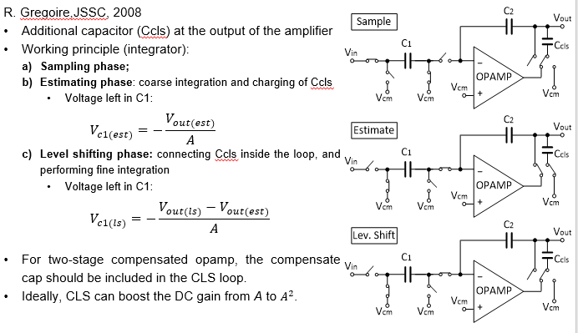
Correlated Level Shifting

Slide 42
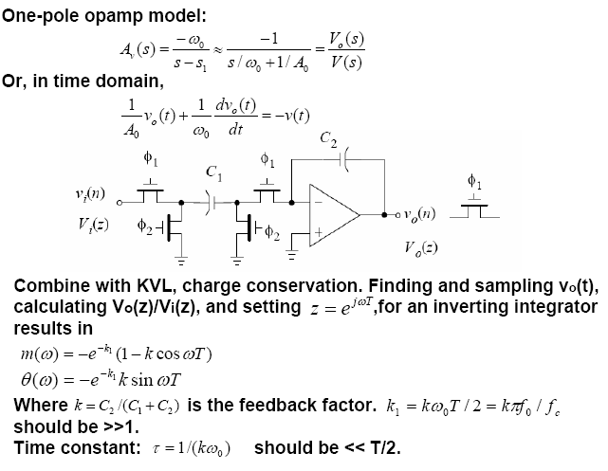
Finite Opamp Bandwidth Effect
ωo UNITY GAIN FREQUENCY

Slide 43
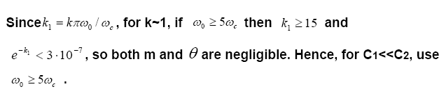
Finite Opamp Bandwidth Effect (Cont’d)
CLOCK FR. > 20.NYQUIST FREQU. FOR AAF.
For k < 1, even higher ωo may be needed. Due to the exponential behavior, the error increases rapidly if ωo is too small!
The derivation assumes vin(t) is constant. If several stages settle simultaneously, or if there is a continuous-time loop of opamp and coupling C’s, then computer analysis (SWITCAP, Fang/Tsividis) is needed.

Slide 44





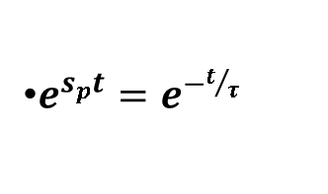



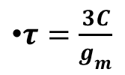
Time Constant of OTA-SC Integrator
BETA: FEEDBACK
FACTOR
At pole S_{P}, V₁=V⁻
Open-loop Gain
Transient term:
Unity-gain conventional integrator, assuming all C is equal:

Slide 45
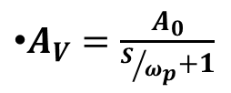

Integrator Using a Two-Stage (Buffered) Opamp (VCVS)
Let Initial Values be V_{C1}=V₁, V_{C2}=0

Slide 46
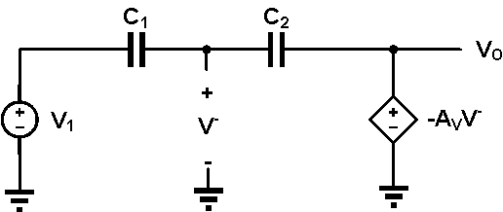
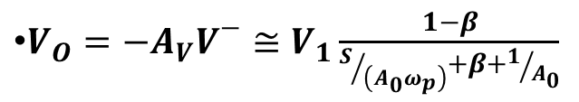

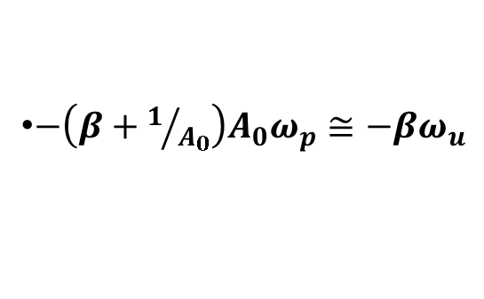
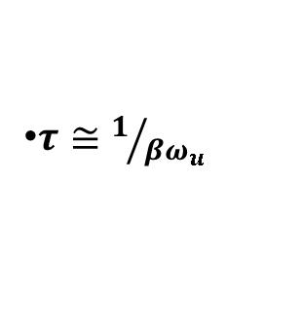
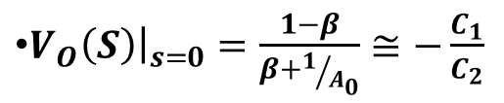
Integrator Using a Two-Stage (Buffer) Opamp
Pole at:
Time Constant:
Settling level:

Slide 47
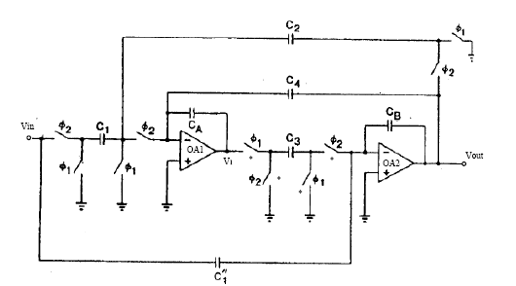
High-Q Biquad
For original phases, both opamps settle when Ф2→1. Changing the *Φ1, they settle separately. V1 changes twice in one cycles, but OA1 still has the same T/2 time (T for the change at Ф1→1.) to settle and to charge C3. The transient when Ф2→1 has a full period to settle in OA1 and OA2 .

Slide 48
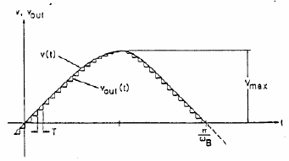
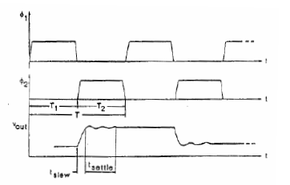

Slew Rate Estimation (1)
Nonlinear slewing followed by linear settling:

Slide 49
Slew Rate Estimation (2)
Much simpler estimate can be based on assuming that Cin is fully discharged in the slewing phase. Then the slew current can be found from
Is ~ Cin.Vin,max/[x.T/2]
Less pessimistic than the previous estimate.

Slide 50


Noise Considerations
Clock feedthrough from switches
External noise coupled in from substrate, power lines, etc
Thermal and 1/f noise generated in switches and opamps
(1) Has components at f=0, fc, can be reduced by dummy switches,
differential circuit, etc. May be signal dependent!
(2) Discussed elsewhere.
(3) Thermal noise in MOSFETs: PSD is
For f≥0, only (one-sided distribution).
Flicker noise:
Total noise PSD: S=ST+Sf .

Slide 51



Noise Considerations (Cont’d)
Noise spectra
Offset compensation (CDS—correlated double sampling); subtracts noise, T/2 second delayed.
CDS:
1. Pick up noise, no signal;
2. Pick up noise, plus signal;
3. Substract the two.

Slide 52

Chopper Stabilization
Fully differential circuits needed.

Slide 53

Chopper Stabilization (Cont’d)
Differential SC amplifier using chopping.

Slide 54



Noise Aliasing
Mean-square values are the same (θ /C )
within all windows.
Direct noise power:
S/H PSD:
S(f): RC filtered direct noise
Most noise at dc!

Slide 55



Equivalent Circuit for Direct Noise
S(f) for direct noise: low-pass filtered and windowed white noise.
For satisfactory settling (0.1%),

Slide 56



Noise Aliasing
Aliasing for

Slide 57

Noise Spectra
For m=0.25, r=31.5!
Noise generated in stage independent of Ron, but the noise generated in preceding stages (direct noise) gets filtered, so the Ron should be as large as possible!

Slide 58

Switched-Capacitor Noise
Two situations; example:
Situation 1: only the sampled values of the output waveform matter; the output spectrum may be limited by the DSP, and hence V_{RMS,n} reduced. Find V_{RMS} from √KTC charges; adjust for DSP effects.
Situation 2: the complete output waveform affects the SNR, including the S/H and direct noise components. Usually the S/H dominates. Reduced by the reconstruction filter.

Slide 59
Calculation of SC Noise (Summary)
In the switch-capacitor branch, when the switch is on, the capacitor charge noise is lowpass-filtered by Ron and C. The resulting charge noise power in C is kTC. It is a colored noise, with a noisebandwidth fn=1/(4RonC). The low-frequency PSD is 4kTRon.
When the switch operates at a rate fc<<fn, the samples of the charge noise still have the same power kTC, but spectrum is now white, with a PSD=2kTC/fc. For the situation when only discrete samples of the signal and noise are used, this is all that we need to know.
For continuous-time analysis, we need to find the powers and spectra of the direct and S/H components when the switch is active. The direct noise is obtained by windowing the filtered charge noise stored in C with a periodic window containing unit pulses of length m/fc. This operation (to a good approximation)
simply scales the PSD, and hence the noise power, by m. The low-frequncy PSD is thus 4mkTRon.

Slide 60

Calculation of SC Noise (Summary) (Cont’d)
To find the PSD of the S/H noise, let the noise charge in C be sampled and- held at fc, and then windowed by a rectangular periodic window
w(t)=0 for n/fc<t<n/fc+m/fc
w(t)=1 for n/fc+m/fc<t<(n+1)/fc
n=0,1,2,…
Note that is windowing reduces the noise power by (1-m) squared(!), since the S/H noise is not random within each period.
Usually, at low frequencies the S/H noise dominates, since it has approximately the same average power as the direct noise, but its PSD spectrum is concentrated at low frequencies. As a first estimate, its PSD can be estimated at for frequencies up to fc/2.

